Slide 1

AI-Powered Social Media Suggestion System
Personalizing User Experience through Machine Learning
2410030171-Chaitra Venugopal
2410030349-Anugoju srija
2410030246-D.pravalika
2410030440-Vinnakota Cherishma Priya
2410030121-Abhinaya Mohita

Slide 2




INTRODUCTION
In today's digital age, users face an overwhelming amount of content, leading to decreased engagement and retention.
User Retention
Engagement
Content Overload
Keeping users engaged amidst vast content.
Boosting interaction with relevant content.
Filtering through irrelevant information.
Our goal: Recommend relevant posts, accounts, or topics using AI/ML.

Slide 3
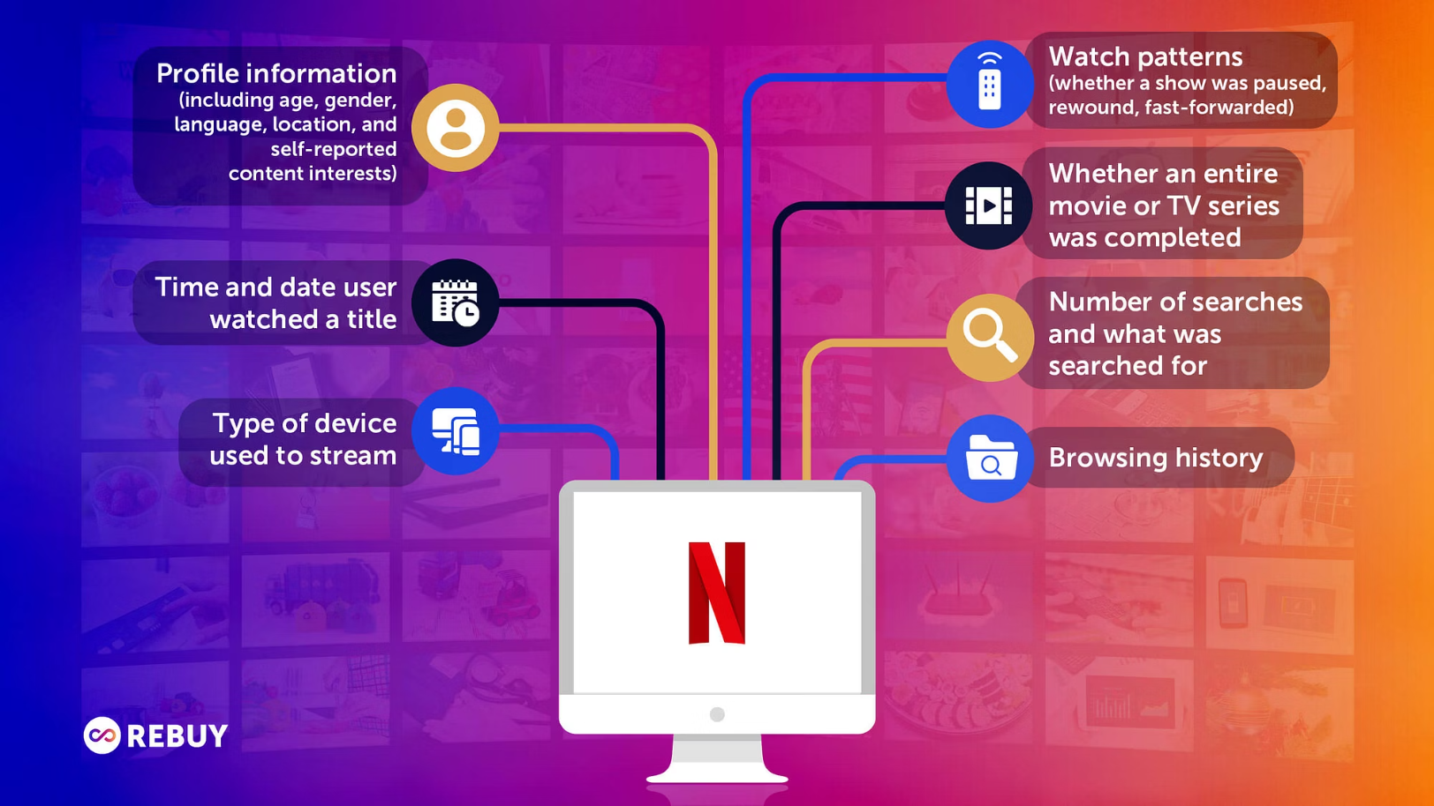
Real-World Inspiration
Our system draws inspiration from successful recommendation engines across various platforms.
Instagram Reels recommendations
Twitter/X timeline suggestions
LinkedIn connection & job suggestions
Inspired by Netflix and Spotify's personalized content delivery.

Slide 4


Our Technology Stack
A robust set of tools powers our AI-driven suggestion system.
Frontend/Backend
ML Tools
HTML,CSS,Javascript,Python,Flask
pandas, NumPy, TensorFlow

Slide 5
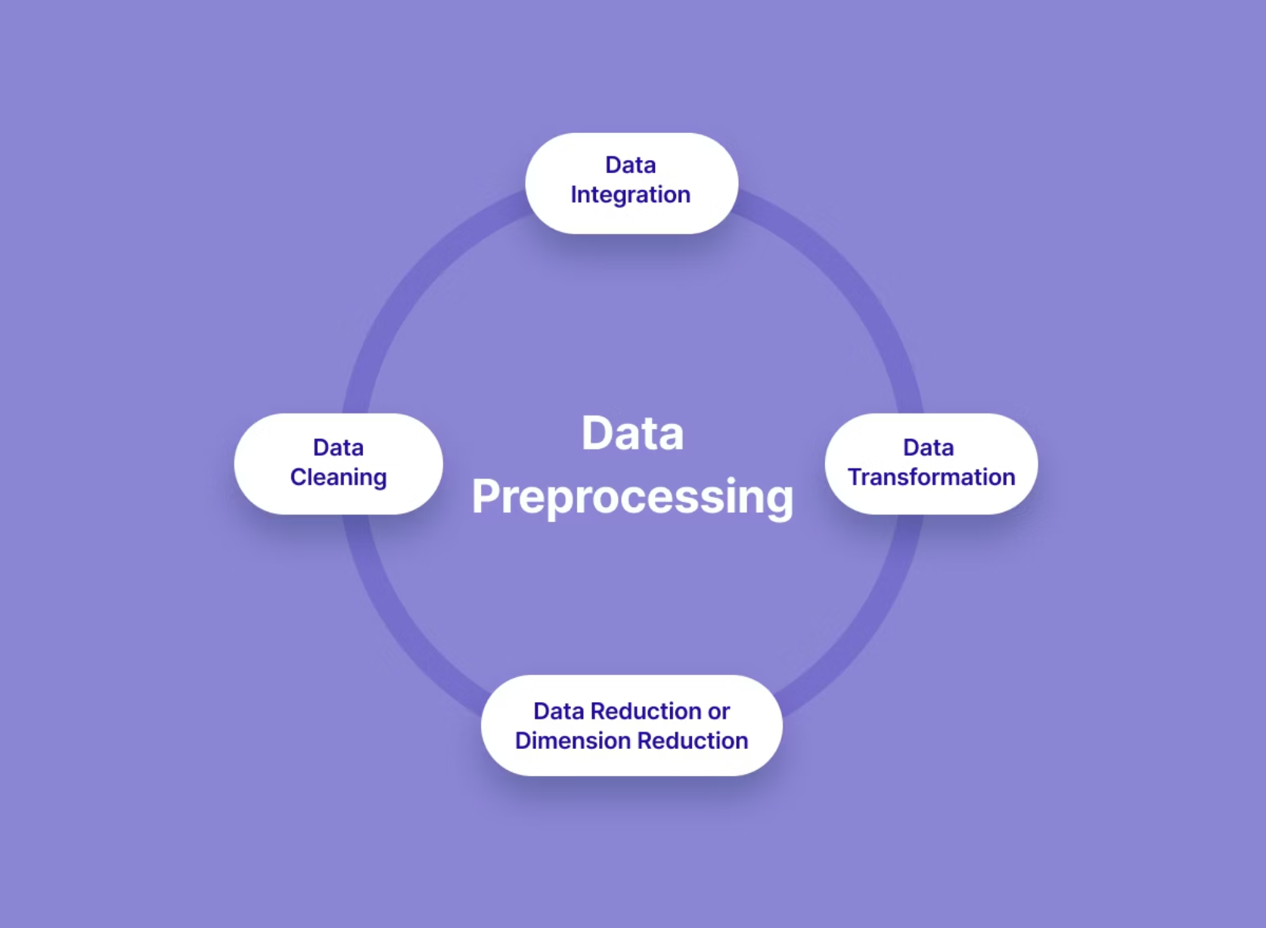
Our Data & How We Use It
We leverage diverse data sources and meticulous preprocessing for effective recommendations.
Where the data comes from:
Public posts Twitter data, Reddit posts, or sample datasets.
What info we use/How we prepare the data:
Post content, hashtags, likes, time
User interests, location
Clean it: Remove Unwanted text or symbols
Break it into parts: Tokenise the next
Covert into numbers: Use embedding so AI understands it
Organize it: Combine,reduce,and format it for training

Slide 6
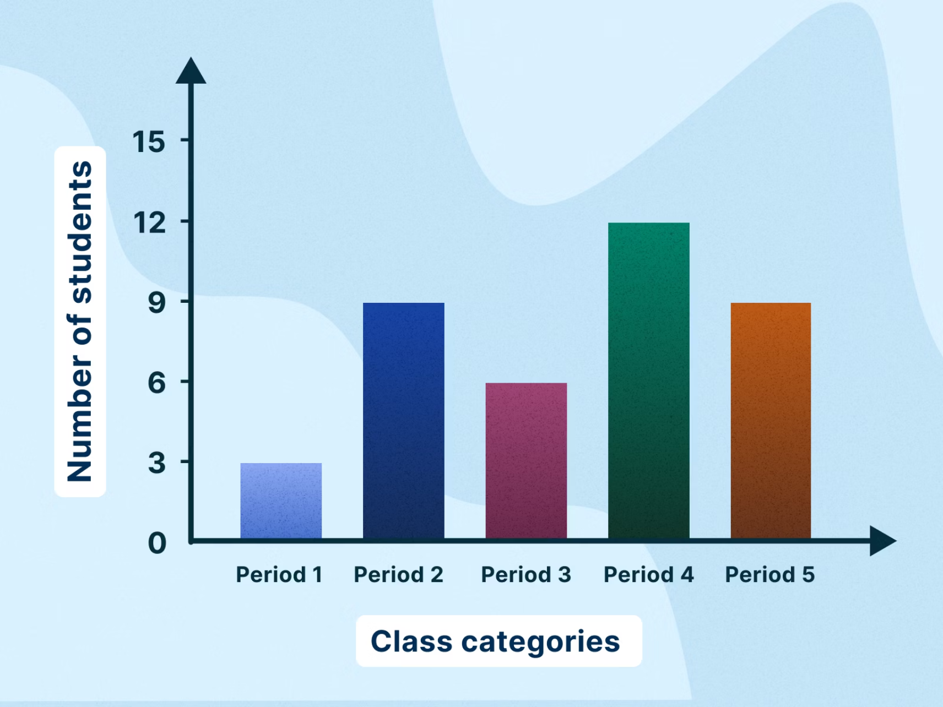
How Our System Works & Measures Success
Our system delivers tailored suggestions, validated by performance metrics.
Sample Input
User likes tech, AI, short videos.
Sample Output
Suggested accounts/posts relevant to user interests.
Accuracy Metrics
Evaluated using classification/regression metrics.

Slide 7
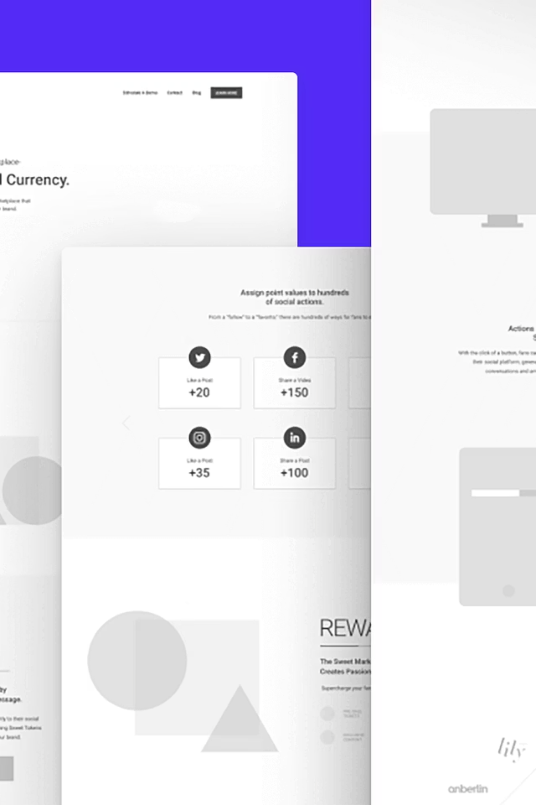
What the user sees:A Personalized Experience
A glimpse into the user experience:
Login —> Home Feed —> Prompt—>Recommendation Section

Slide 8
Learnings & Future Scope
We learned a lot while researching this project and found some areas to improve it in the future.
Challenges
Future Enhancements
Dealing with messy or unclear data
Add voice or emotion-based suggestions
Suggesting content for brand-new users
Use live feedback to make suggestions better over time
Improving the model’s accuracy and results
Track user activity across different apps/platforms
Deciding between live suggestions or scheduled updates
Avoid biased or false content in suggestions.

Slide 9

Conclusion
Our AI-powered system helps by showing only the most relevant and personalised content-making the user experience more engaging and meaningful.
"Personalization is key to retaining attention in the content jungle."

